Slide 1
Status Report: KubeDB
Maruf • 12.07.2018

Slide 2
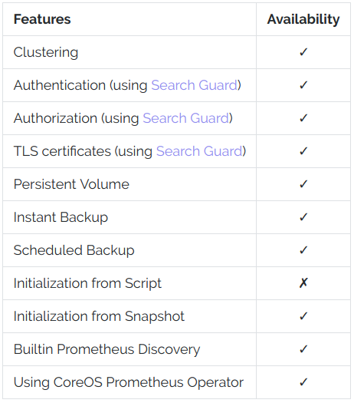
Supported Elasticsearch Features

Slide 3
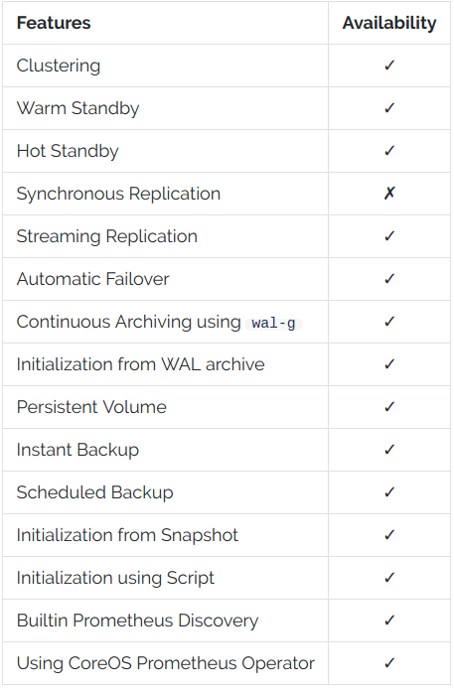
Supported Postgress Features

Slide 4
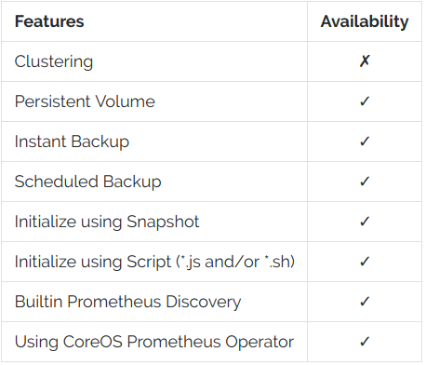
Supported MongoDB Features

Slide 5
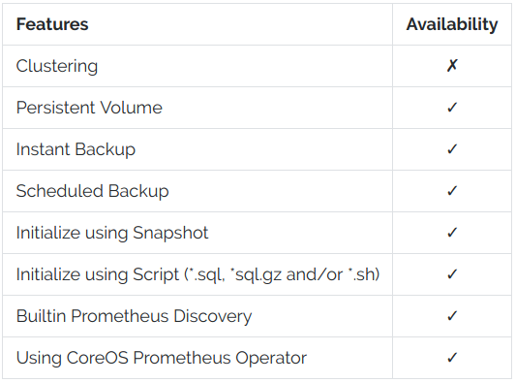
Supported MySQL Features

Slide 6
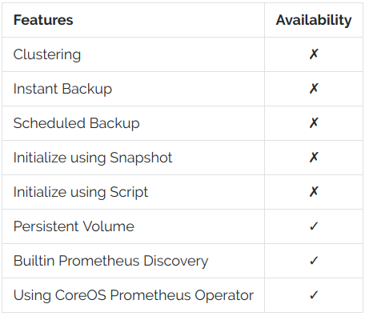
Supported Redis Features

Slide 7
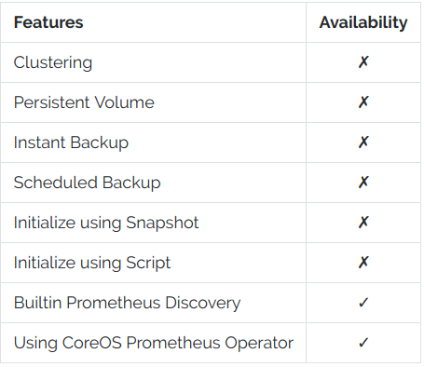
Supported Memcached Features

Slide 8
Progress
Recent progress:
User management
On Progress
https://github.com/kubedb/project/issues/165
Explore service broker integration
On Progress
https://github.com/kubedb/project/issues/83
MongoDB Clustering - Replica Set
On Progress
https://github.com/kubedb/project/issues/175
Support ENV variables in CRDs.
Merged to master
https://github.com/kubedb/project/issues/163
Support custom configuration
On Progress
https://github.com/kubedb/project/issues/187

Slide 9
Goals for next meeting
Discuss how user management will be introduced to KubeDB
Further plan for future work

